Slide 1
Evaluating Fast Algorithms for Convolutional Neural Networks on FPGAs
Bijeet Basak(IMT2022510)
Yash Sengupta(IMT2022532)
Niranjan Gopal(IMT2022543)
Dikshant Mahawar(IMT2022549)
Abhinav Deshpande(IMT2022580)
Teerth Bhalgat(IMT2022586)

Slide 2
Outline
How Winograd Works?
Overlap & Save(OaS) and Overlap & Add(OaA)
Block Diagram
PE Implementation
How FFT Works?
Resource Utilization
Output Waveforms
Results

Slide 3
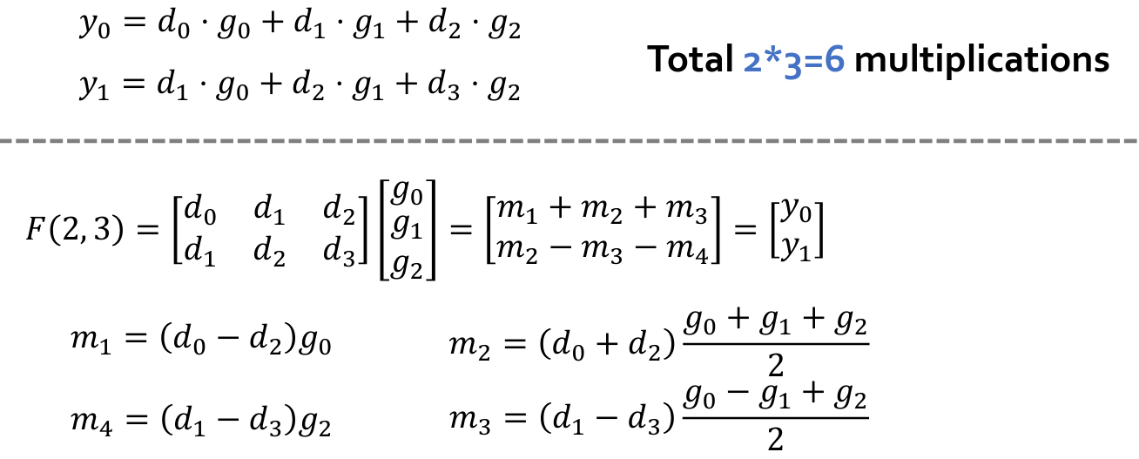
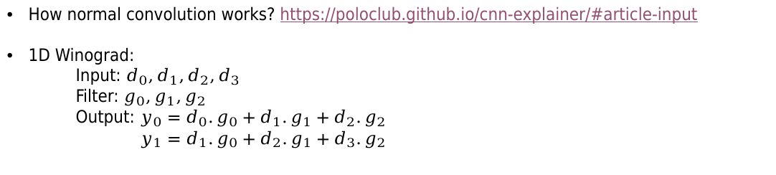
How Winograd Works?
How normal convolution works? https://poloclub.github.io/cnn-explainer/#article-input
1D Winograd:
Input: $d_{0},d_{1},d_{2},d_{3}$
Filter: $g_{0},g_{1},g_{2}$
Output: $y_{0}=d_{0}.g_{0}+d_{1}.g_{1}+d_{2}.g_{2}$
$y_{1}=d_{1}.g_{0}+d_{2}.g_{1}+d_{3}.g_{2}$
Link: https://abhinav-gh.github.io/Fast-CNN-using-Winograd/

Slide 4
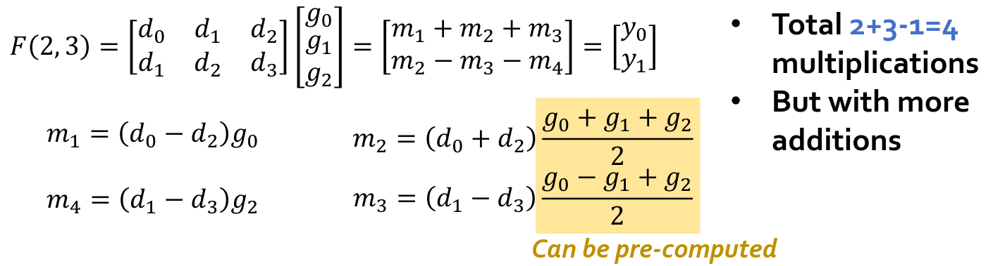
How Winograd Works?

Slide 5

2D Winograd

Slide 6

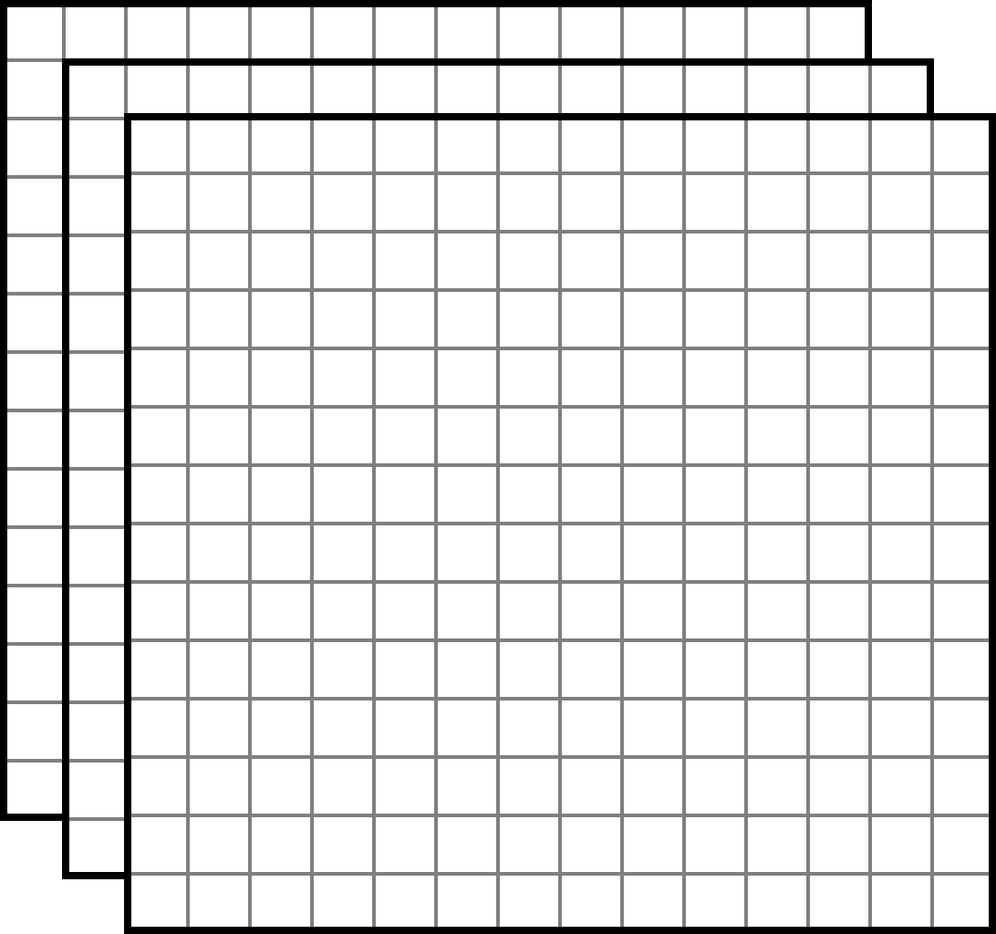
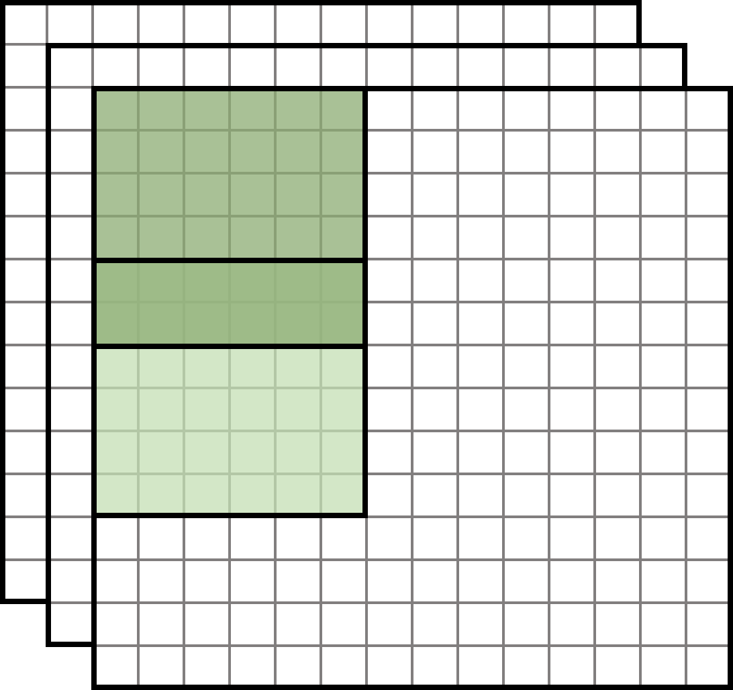
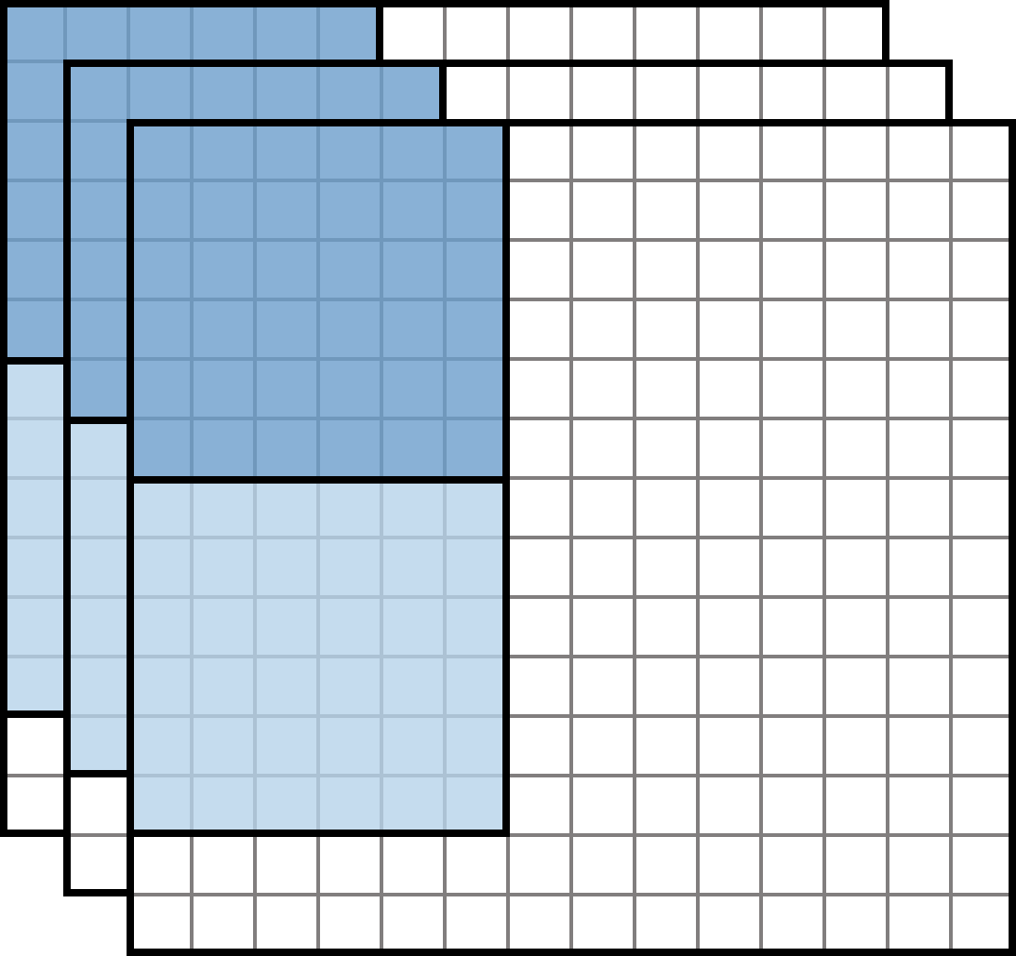
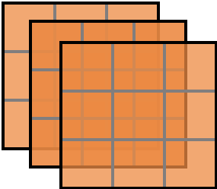
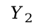
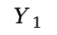
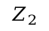
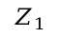
Overlap & Add(OaA)
Fast convolution
Y
m
stride=n
n
r
$$Y_{1}$$
$$Z_{1}$$
r
row
H
$$Y_{2}$$
row
R
$$Z_{2}$$
col
col
M
N
W
N filters
C
Input feature maps
Output feature maps

Slide 7
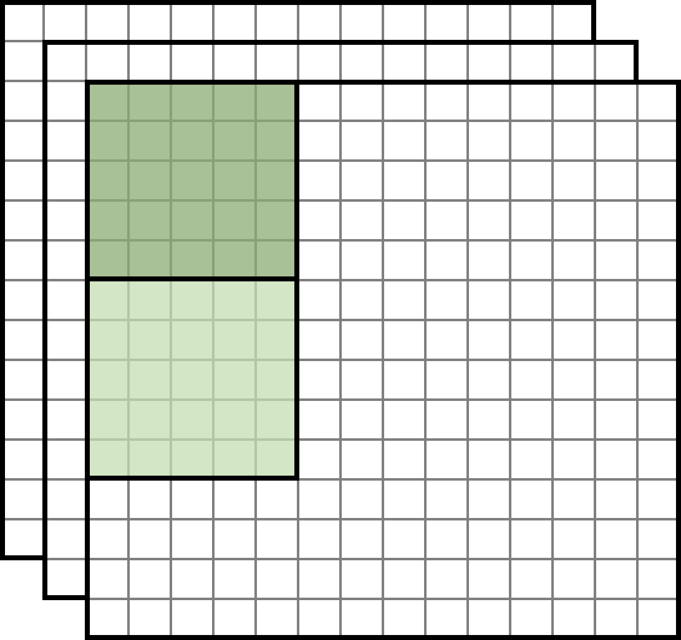
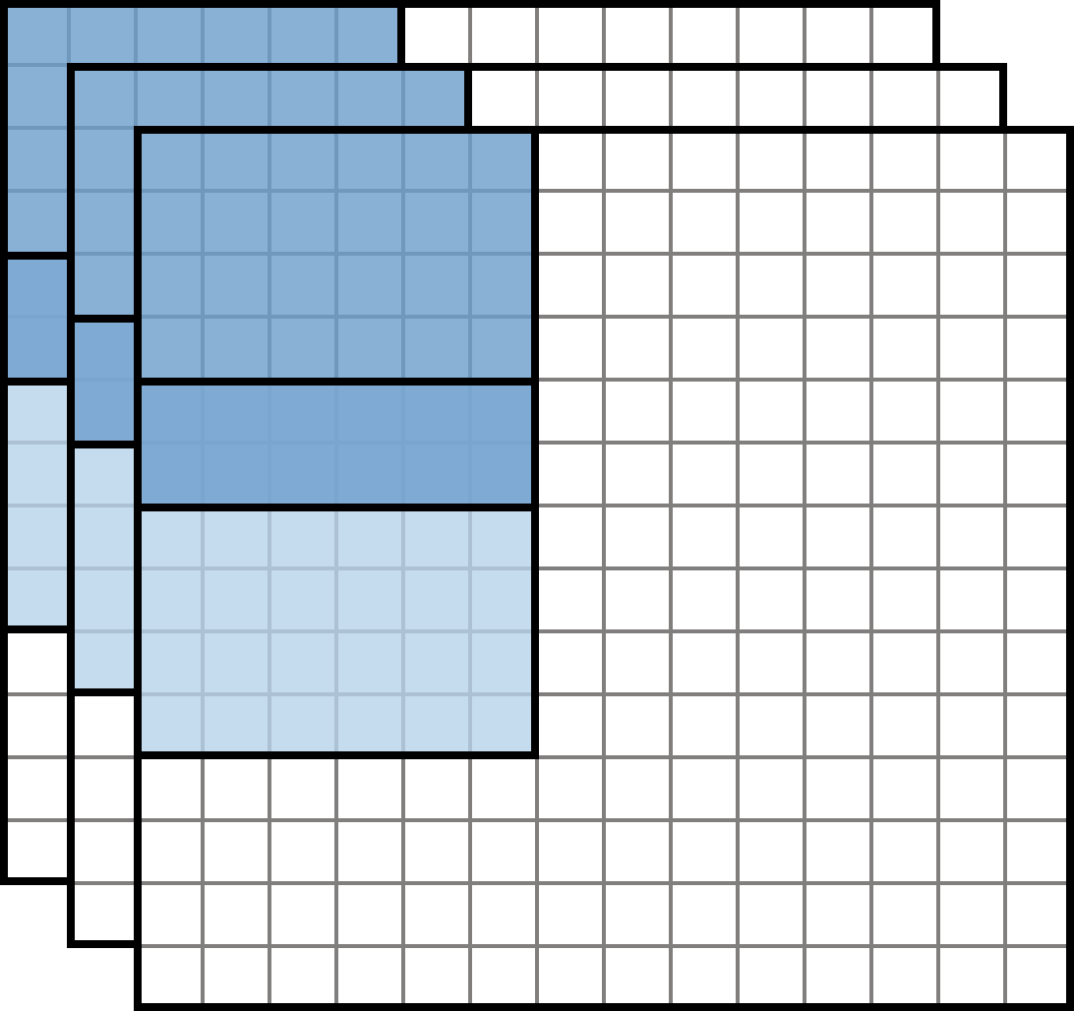
Overlap & Save(OaS)
Fast convolution
Y
m
stride=n
n
r
$$Y_{1}$$
$$Z_{1}$$
r
row
H
$$Y_{2}$$
row
R
$$Z_{2}$$
col
col
M
N
W
N filters
C
Input feature maps
Output feature maps

Slide 8
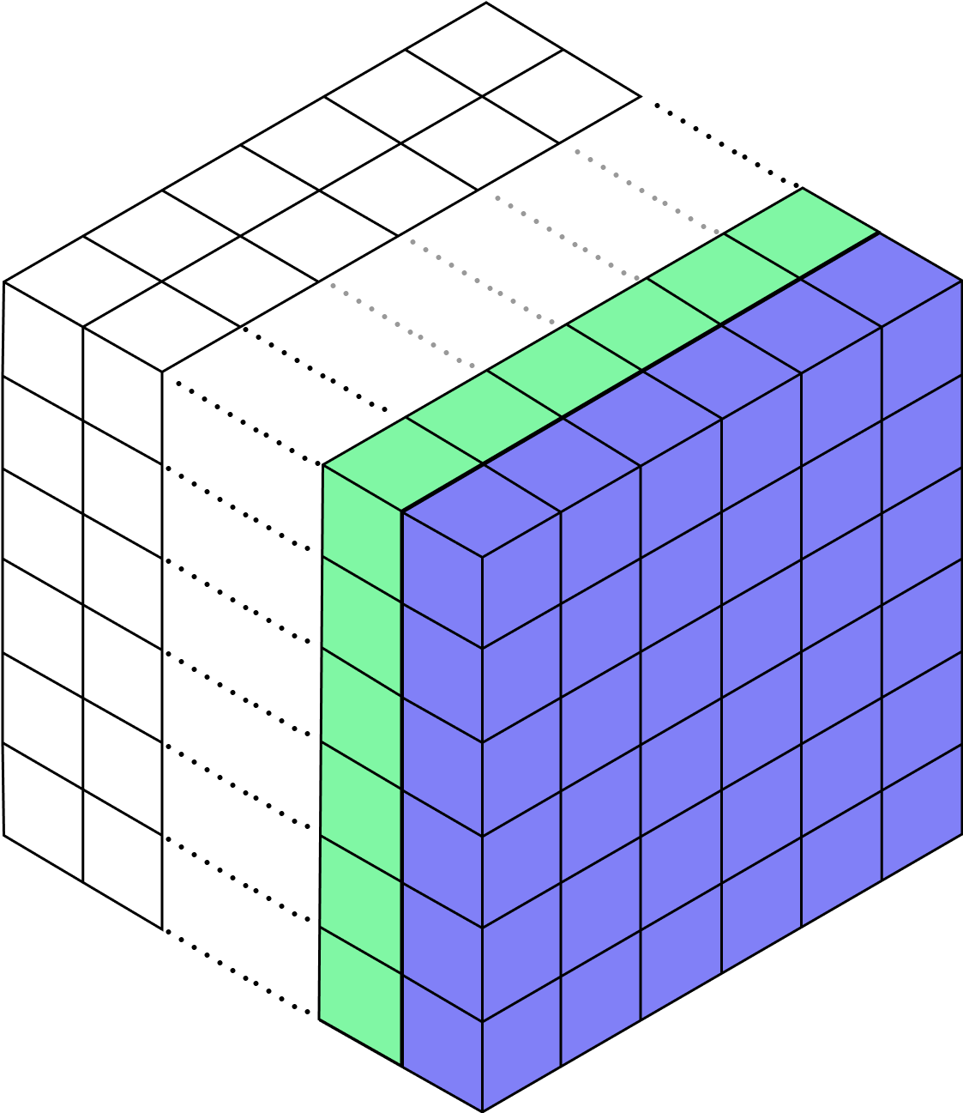
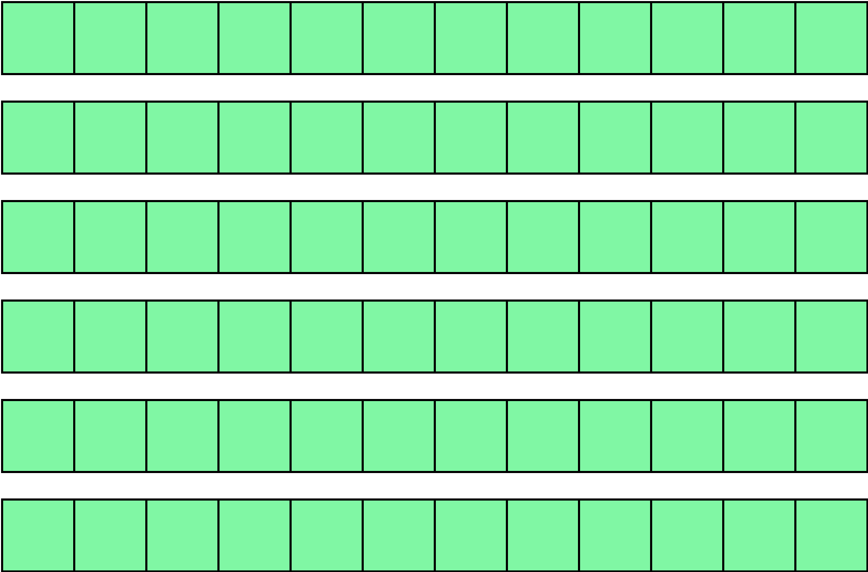
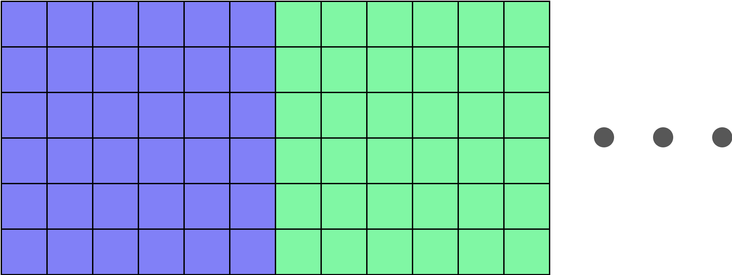
Block Diagram
MxW
H,W
FIFO
M

Slide 9
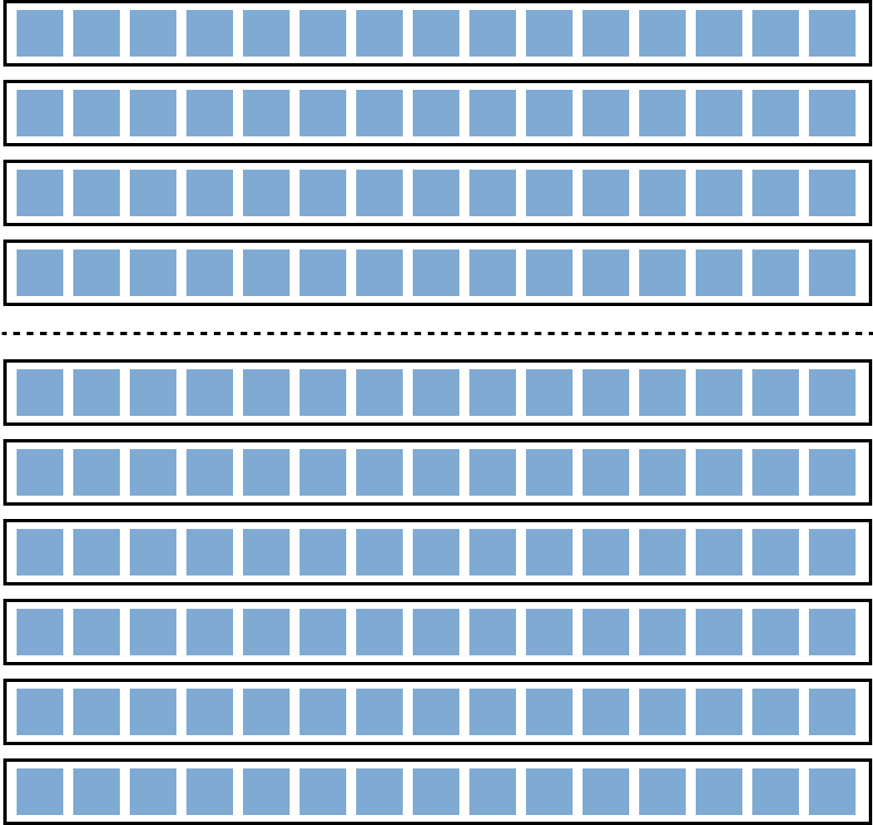
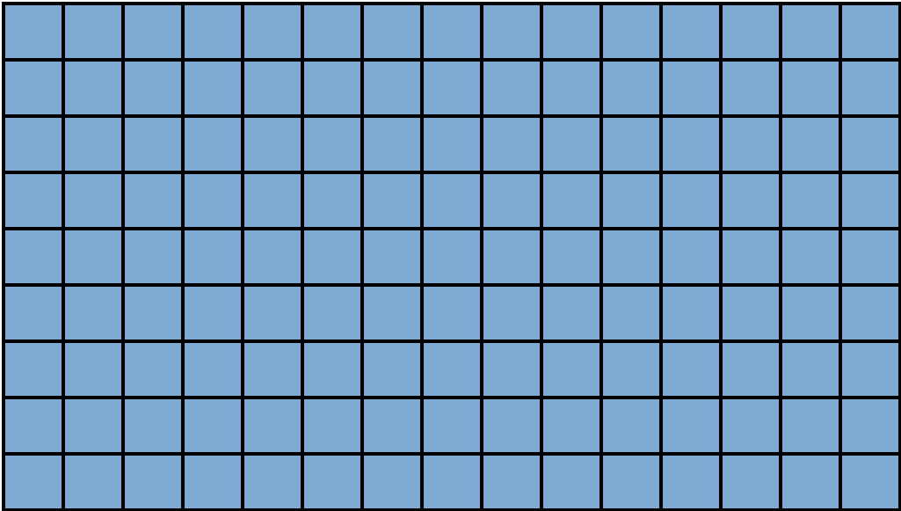
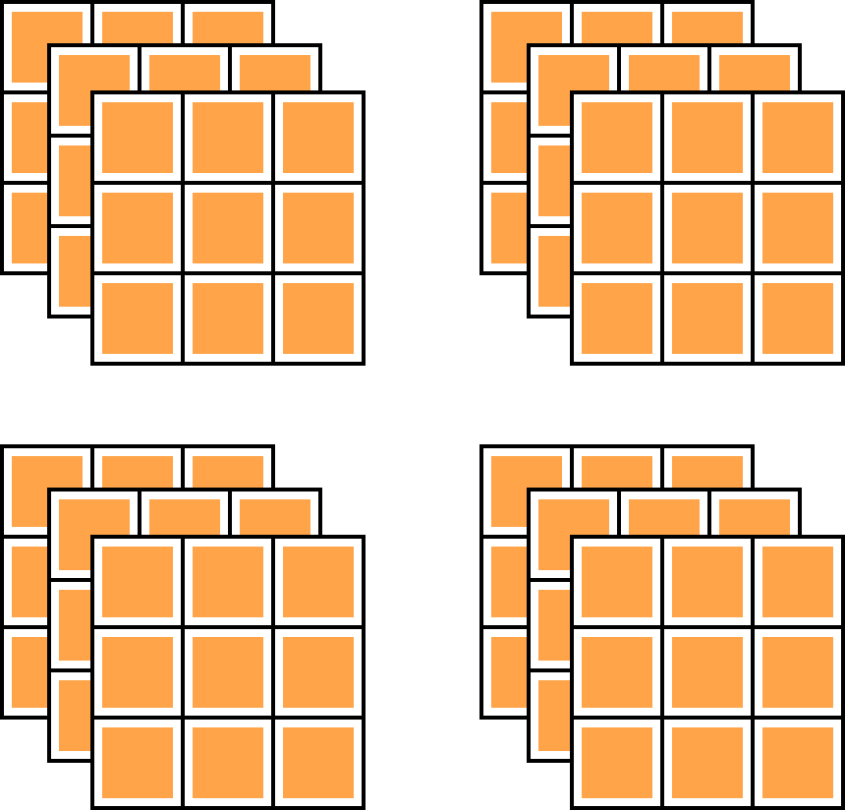
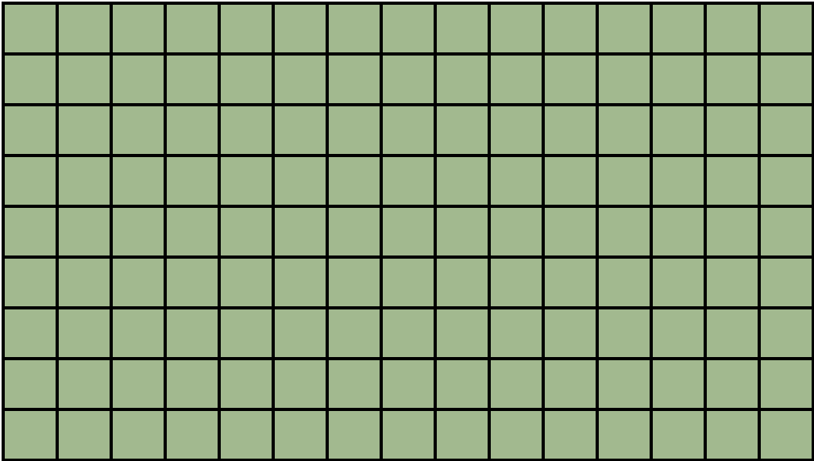
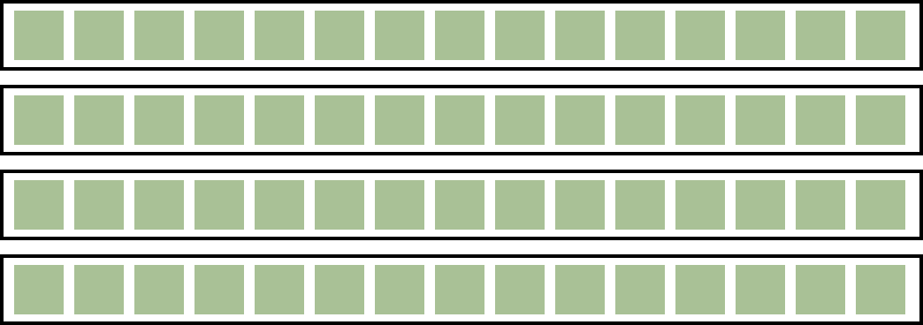
Block Diagram
MxW
MxW
M
FIFO
m
H
input tile
n
filter buffer
input line buffer
PE
PE
PE
NxC
C
FIFO
output tile
m
R
NxC
output line buffer

Slide 10
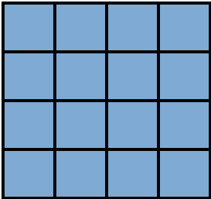
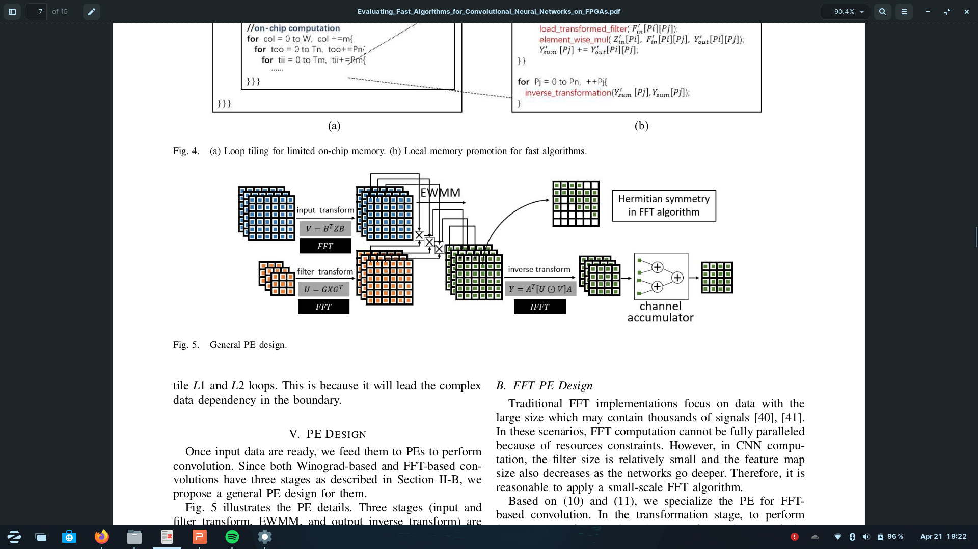
PE Implementation
Input processing and kernel processing:
4x4
1x16

Slide 11
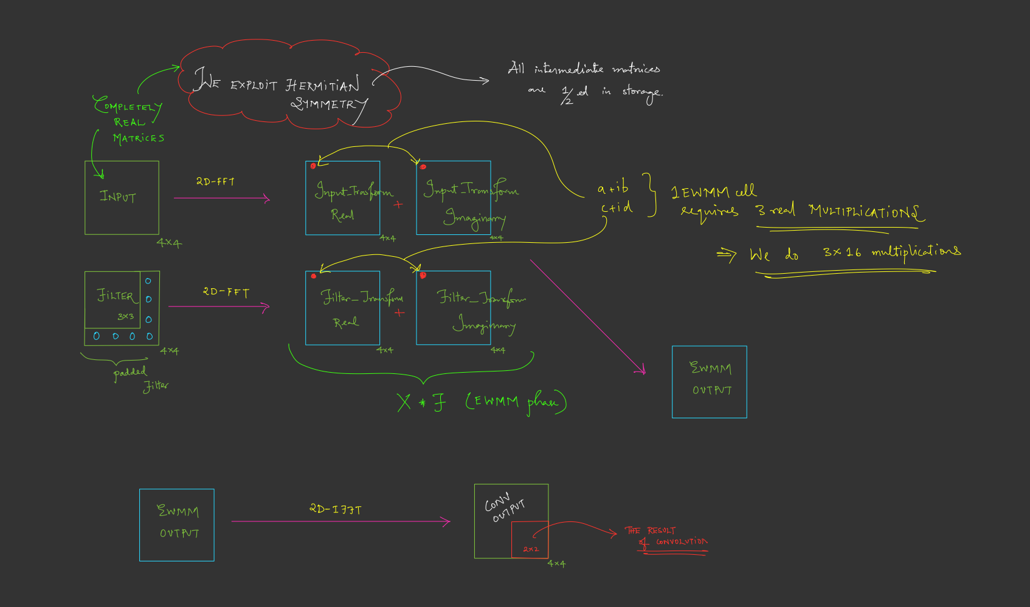
2D FFT

Slide 12
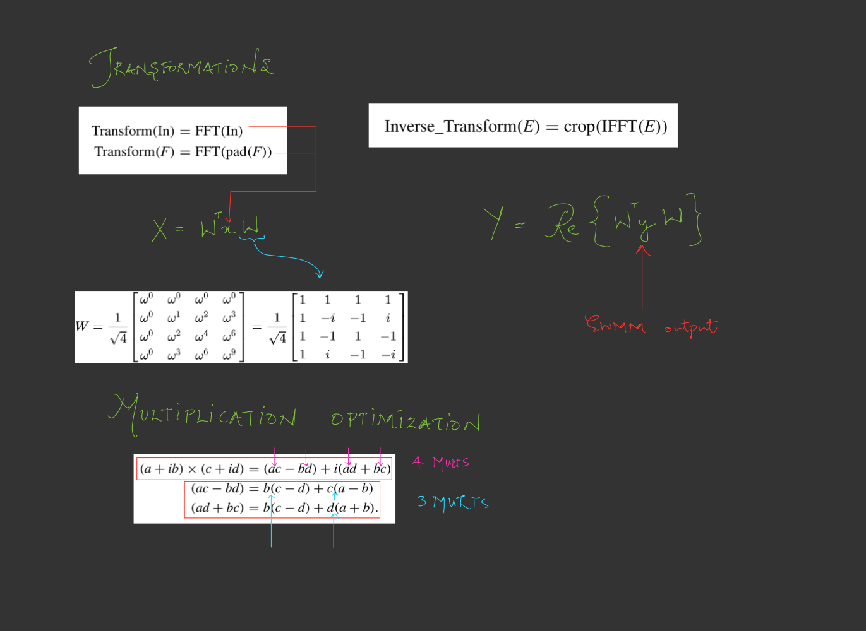
2D FFT

Slide 13
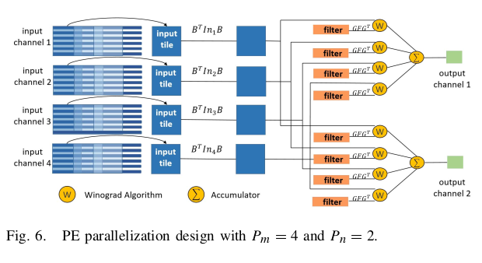
PE Parallelization

Slide 14
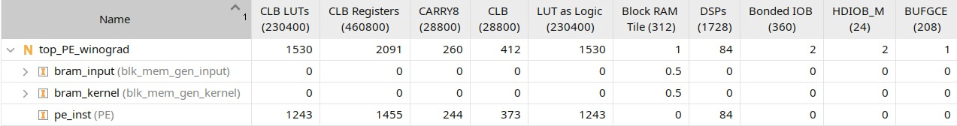
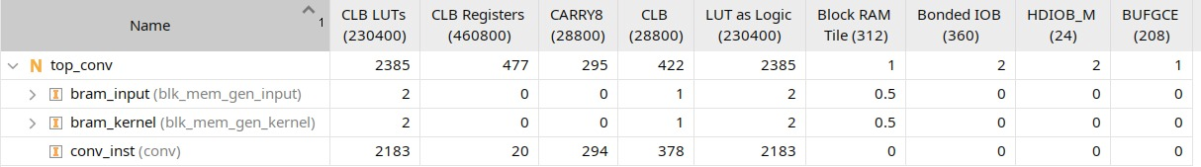
Resource Utilization
Winograd PE
PE using standard spatial convolution

Slide 15
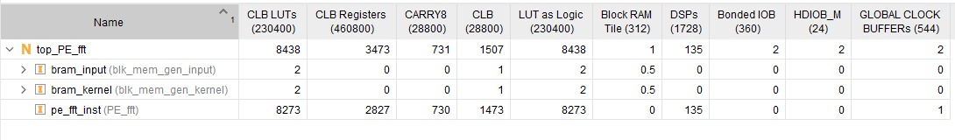
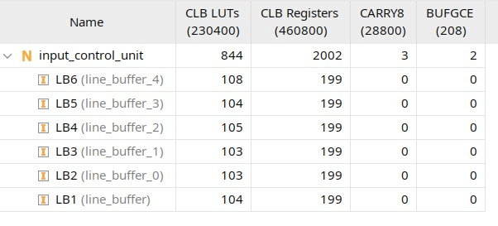
Resource Utilization
PE FFT
Circular Buffer

Slide 16
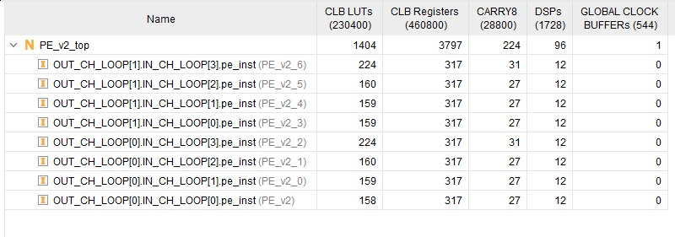
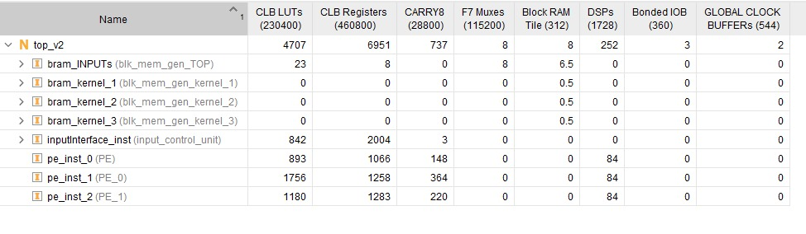
Resource Utilization
PE parallelization with $P_{m}=4$ and $P_{2}=2$
Input interface with PE

Slide 17
Performance
Winograd
Clock is 10ns and positive slack is 6.139ns
Number of operations = 25
f_max = 0.259 GHz
GOPS_max = 6.475 GOPs
Spatial Convolution
Clock is 11.5ns and positive slack is 0.0795ns
Number of operations = 9
f_max = 0.0869565 GHz
GPOS_max = 0.7826 GOPs
FFT
Clock is 10ns and positive slack is 6.139ns
Number of operations = 35
f_max = 0.2044 GHz
GOPS_max = 7.15 GOPs

Slide 18
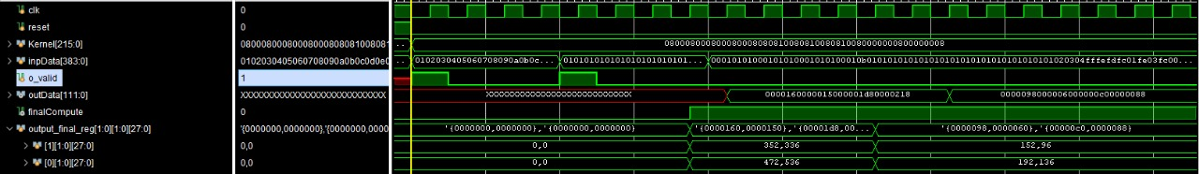
Output Waveforms
PE Winograd

Slide 19
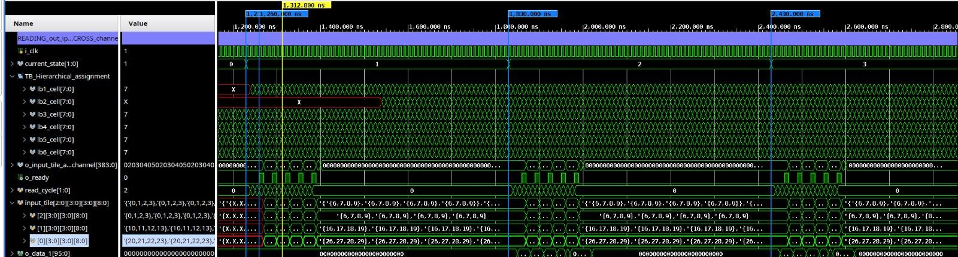
Output Waveforms
Circular Buffer

Slide 20
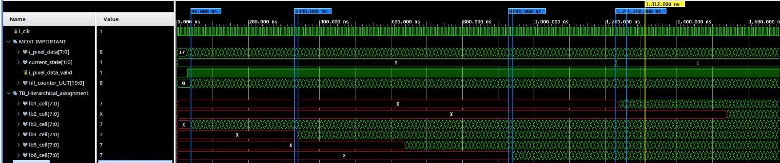
Output Waveforms
Line Buffer

Slide 21
Questions
?
Evaluating Fast Algorithms for COnvolutional Neural Networks on FPGAs
Github link: https://github.com/Niranjan-GopaL/NN_Fast_Algorithms_on_FPGA

Slide 22
Thank You

Slide 23
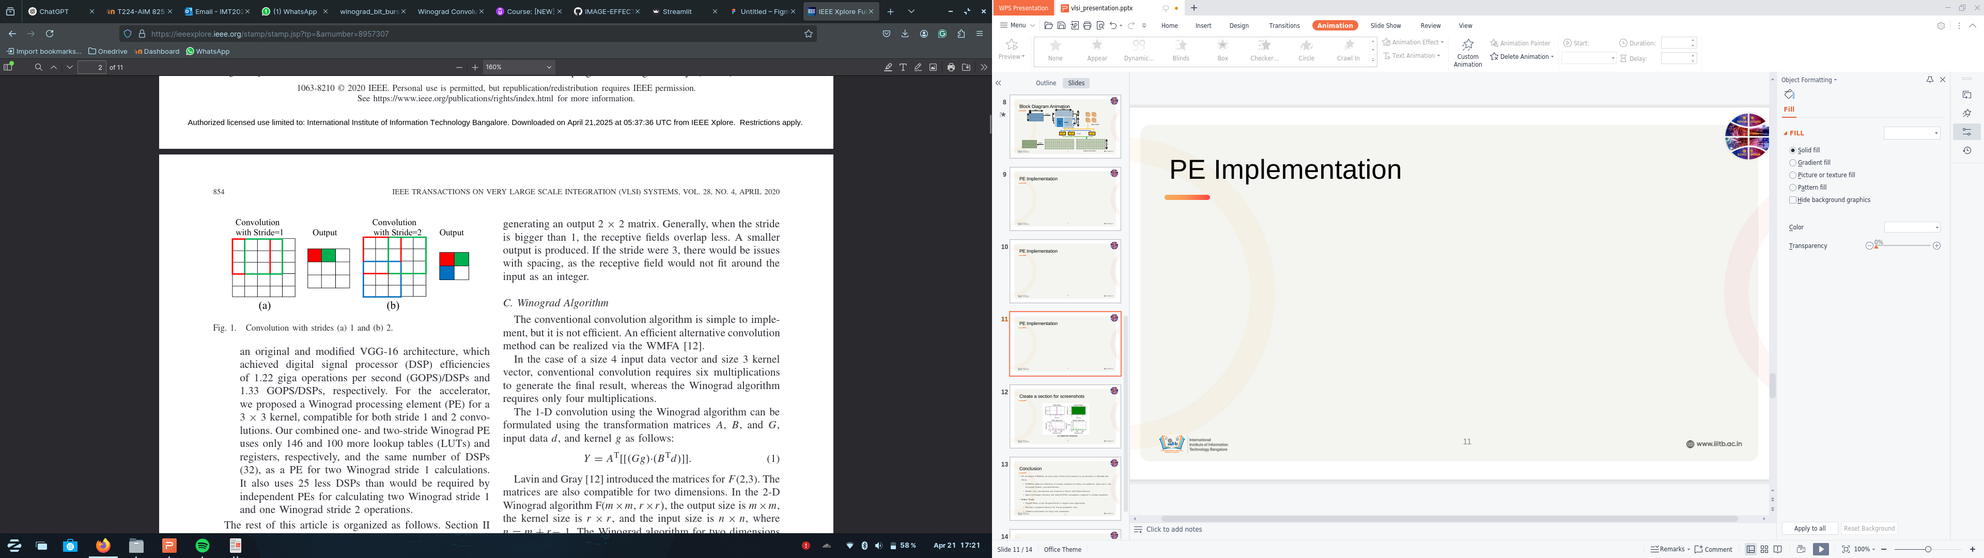
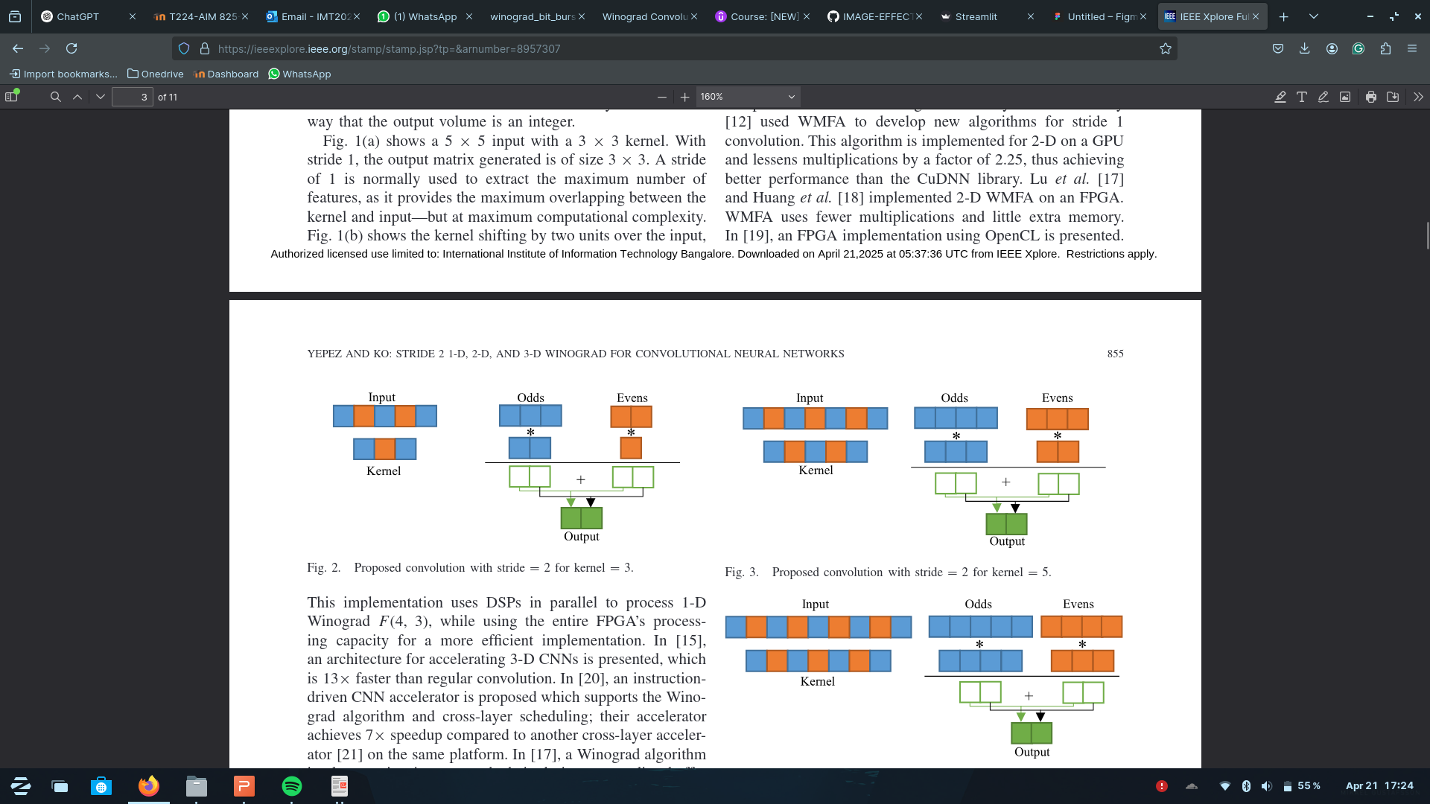
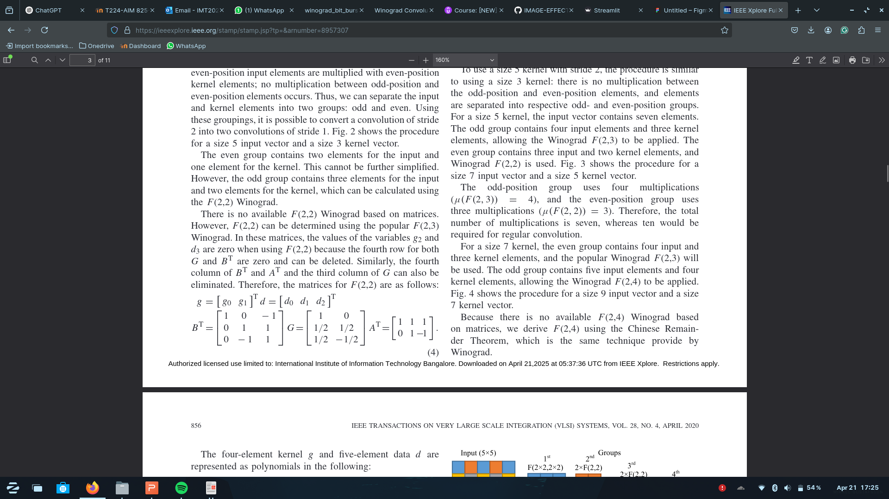
Additional Information
Winograd for stride=2

Slide 24
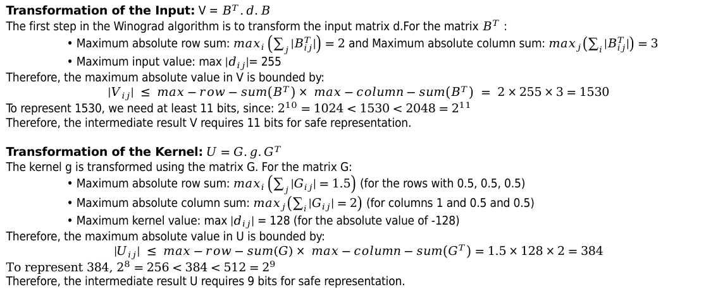
Additional Information
Transformation of the Input: V = $B^{T}.d.B$
The first step in the Winograd algorithm is to transform the input matrix d.For the matrix $B^{T}$ :
• Maximum absolute row sum: $\max_{i}\left(\sum_{j}{|B_{ij}^{T}|}\right)=2$ and Maximum absolute column sum: $\max_{j}\left(\sum_{i}{|B_{ij}^{T}|}\right)=3$
• Maximum input value: max ${|d}_{ij}|$= 255
Therefore, the maximum absolute value in V is bounded by:
$${|V}_{ij}| ≤ max−row−sum\left(B^{T}\right)× max−column−sum\left(B^{T}\right) = 2×255×3=1530$$
To represent 1530, we need at least 11 bits, since: $2^{10}=1024<1530<2048=2^{11}$
Therefore, the intermediate result V requires 11 bits for safe representation.
Transformation of the Kernel: $U=G.g.G^{T}$
The kernel g is transformed using the matrix G. For the matrix G:
• Maximum absolute row sum: $\max_{i}\left(\sum_{j}{|G_{ij}|}=1.5\right)$ (for the rows with 0.5, 0.5, 0.5)
• Maximum absolute column sum: $\max_{j}\left(\sum_{i}{|G_{ij}|}=2\right)$ (for columns 1 and 0.5 and 0.5)
• Maximum kernel value: max ${|d}_{ij}|$ = 128 (for the absolute value of -128)
Therefore, the maximum absolute value in U is bounded by:
$${|U}_{ij}| ≤ max−row−sum\left(G\right)× max−column−sum\left(G^{T}\right)=1.5×128×2=384$$
To represent 384, $2^{8}=256<384<512=2^{9}$
Therefore, the intermediate result U requires 9 bits for safe representation.

Slide 25
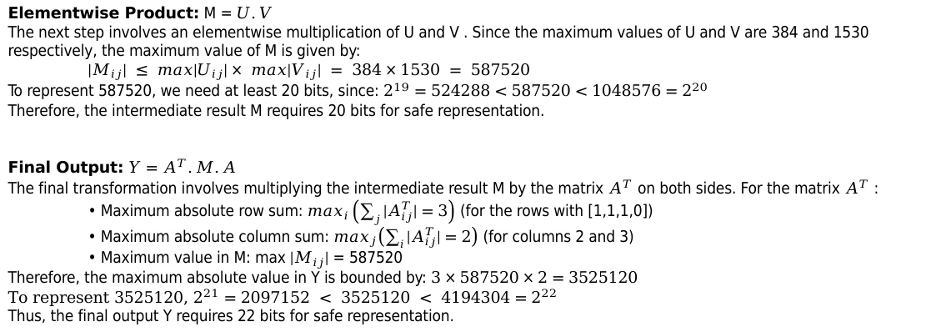
Additional Information
Elementwise Product: M = $U.V$
The next step involves an elementwise multiplication of U and V . Since the maximum values of U and V are 384 and 1530 respectively, the maximum value of M is given by:
${|M}_{ij}| ≤ max|U_{ij}|× max|V_{ij}| = 384×1530 = 587520$
To represent 587520, we need at least 20 bits, since: $2^{19}=524288<587520<1048576=2^{20}$
Therefore, the intermediate result M requires 20 bits for safe representation.
Final Output: $Y=A^{T}.M.A$
The final transformation involves multiplying the intermediate result M by the matrix $A^{T}$ on both sides. For the matrix $A^{T}$ :
• Maximum absolute row sum: $\max_{i}\left(\sum_{j}{|A_{ij}^{T}|}=3\right)$ (for the rows with [1,1,1,0])
• Maximum absolute column sum: $\max_{j}\left(\sum_{i}{|A_{ij}^{T}|}=2\right)$ (for columns 2 and 3)
• Maximum value in M: max ${|M}_{ij}|$ = 587520
Therefore, the maximum absolute value in Y is bounded by: $3×587520×2=3525120$
To represent 3525120, $2^{21}=2097152 < 3525120 < 4194304=2^{22}$
Thus, the final output Y requires 22 bits for safe representation.

Slide 26
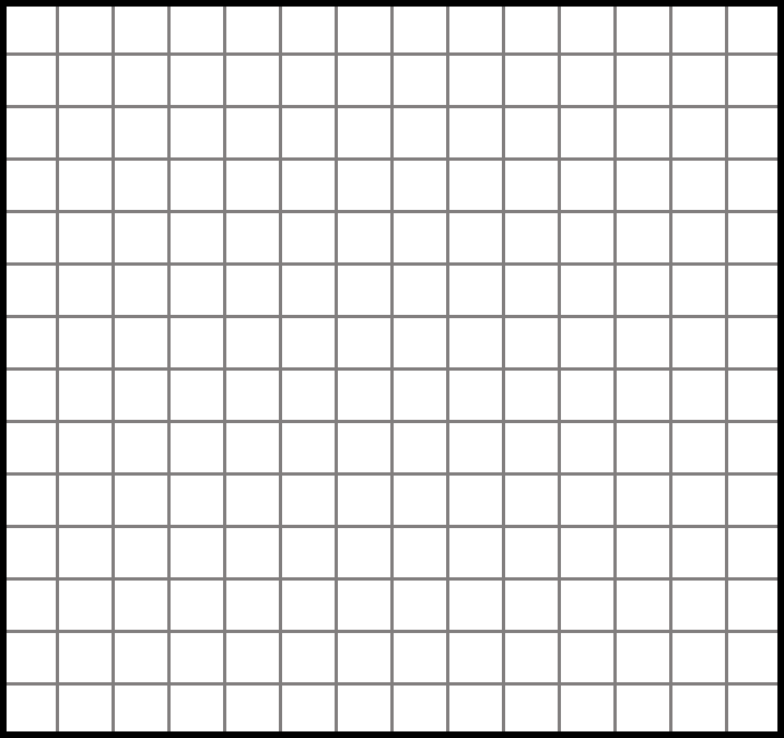
Additional Information
Striding in Winograd

